Slide 1
Introduction to Legal Judgement Prediction
March 2023 Yuye

Slide 2
Contents
Background
Related Works
TopJudge
LADAN
NeurJudge
CTM
Conclusion

Slide 3
Contents
Background
Related Works
TopJudge
LADAN
NeurJudge
CTM
Conclusion

Slide 4
Legal Judgement Prediction
Predicting judgement result based on the facts of a case, which consists of multiple subtasks, including:
Law articles
Charges
Fines
Term of penalty.

Slide 5
Challenges
Challenge 1: Dependencies among multiple tasks
Challenge 2: Confusing law articles/charges
Challenge 3: Label imbalance

Slide 6
Contents
Background
Related Works
TopJudge
LADAN
NeurJudge
CTM
Conclusion

Slide 7
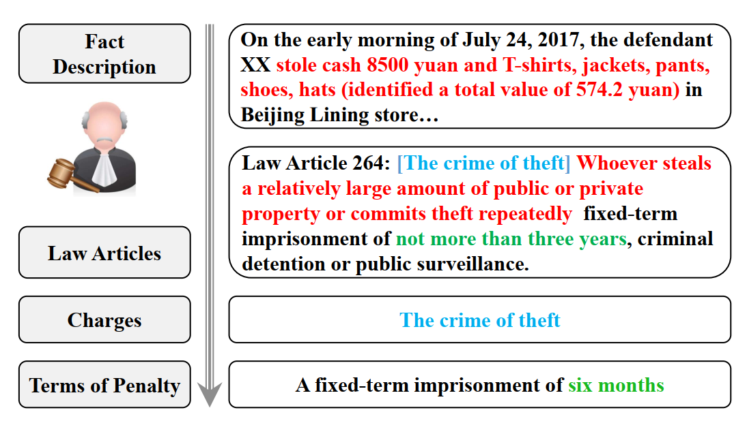
TopJudge

Slide 8
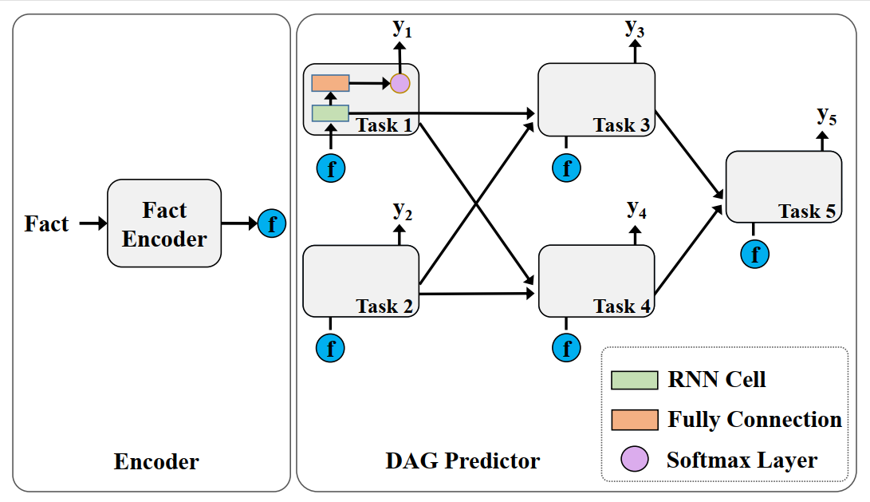
TopJudge
Joint learning framework
Notes:
Different to conventional MTL models which focus on how to share parameters among relevant tasks, TOPJUDGE models the explicit dependencies among these subtasks with scalable DAG forms.

Slide 9
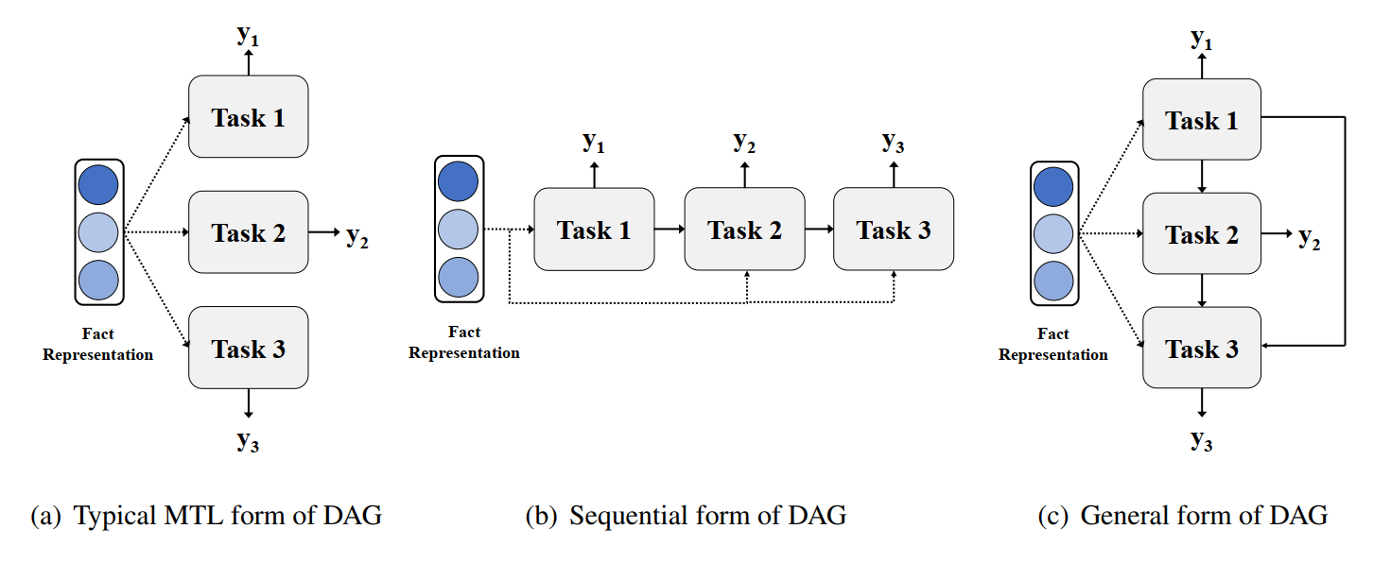
TopJudge

Slide 10
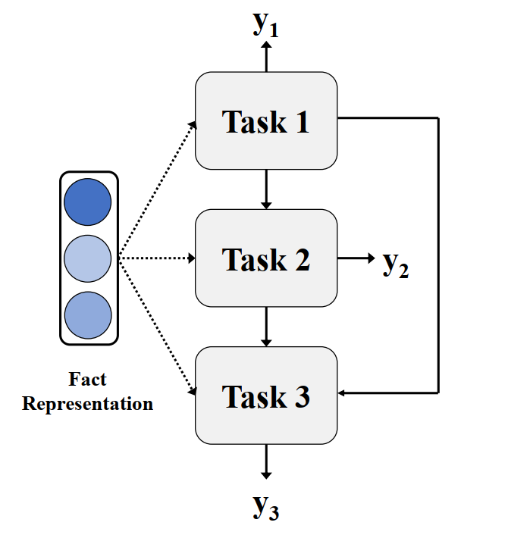
TopJudge
Task 1: Law article
Task 2: Charges
Task 3: Terms of penalty

Slide 11
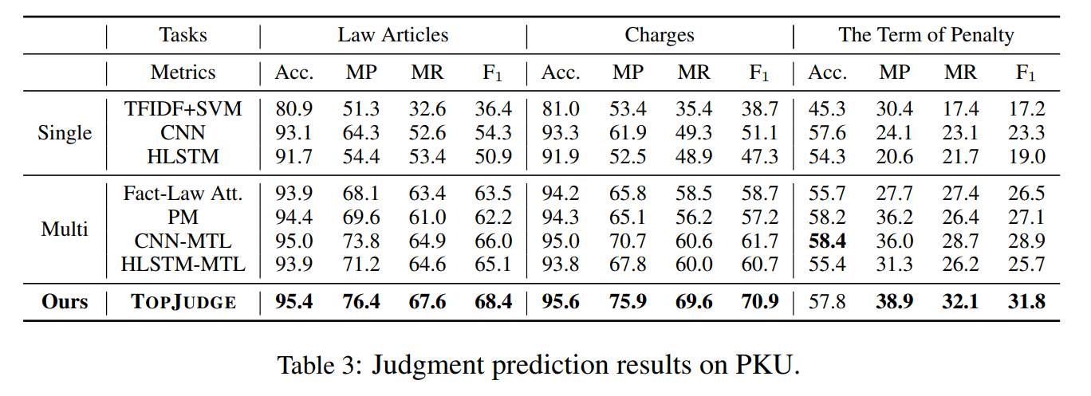
TopJudge

Slide 12
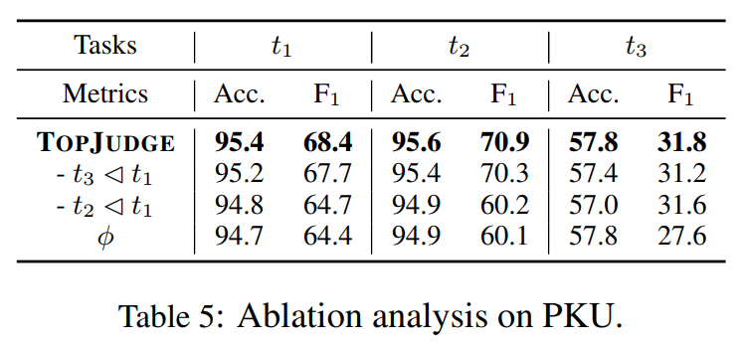
TopJudge

Slide 13
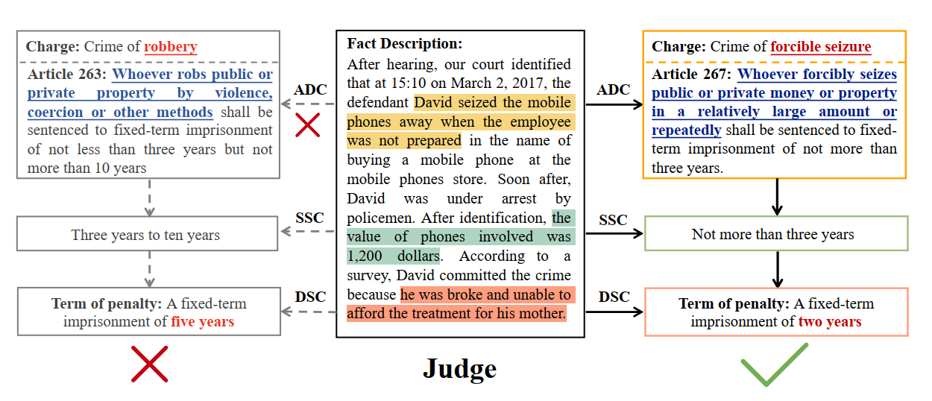
LADAN
Error due to confusing laws
Notes:
The only difference is that the Article 263 also describes violent behaviors while the Article 267 not.

Slide 14
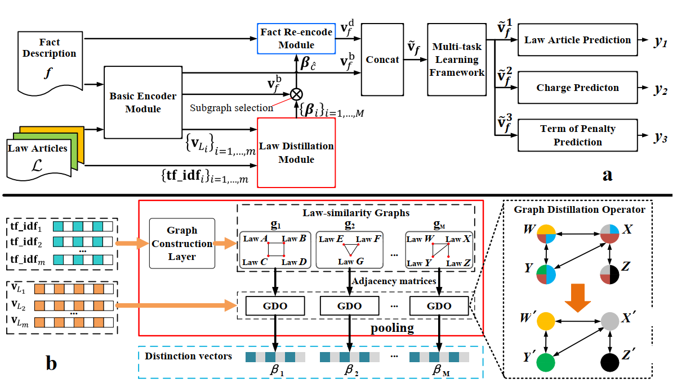
LADAN

Slide 15
LADAN

Slide 16
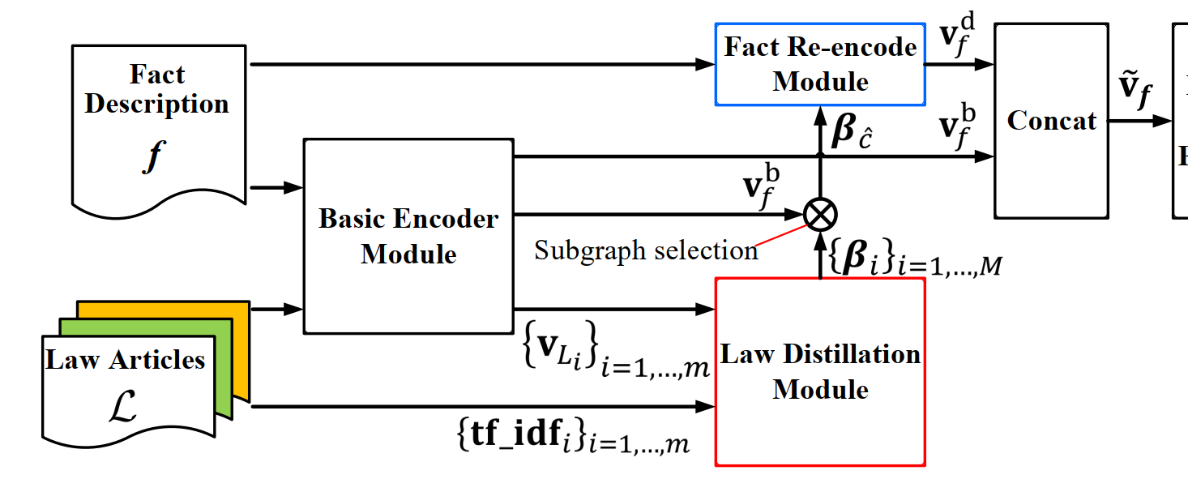
LADAN

Slide 17
LADAN

Slide 18
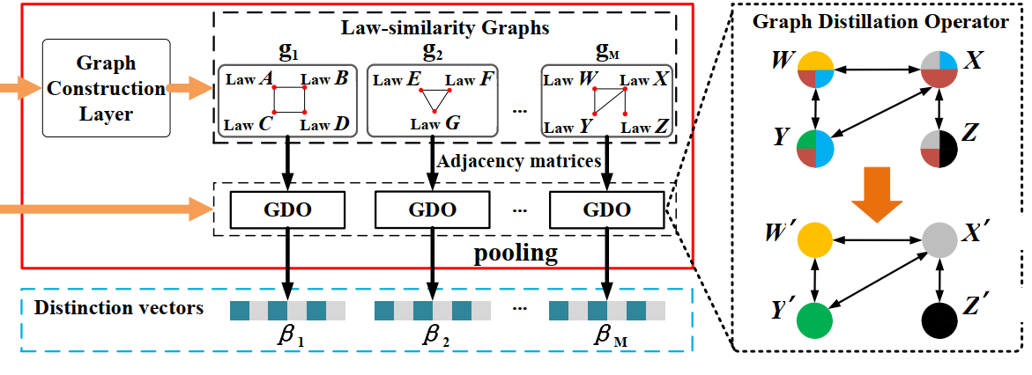
LADAN

Slide 19
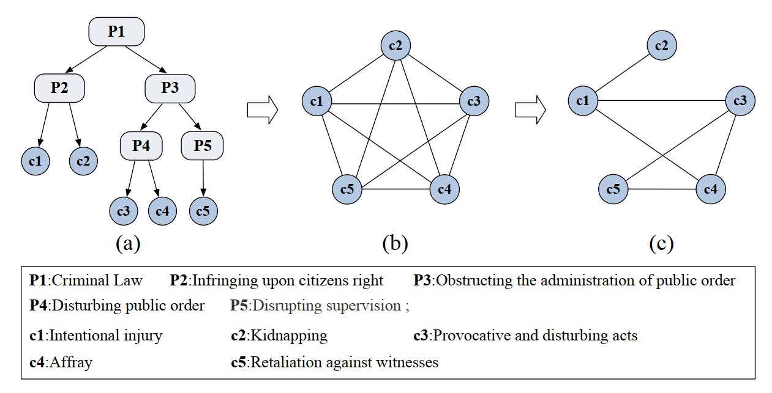
LADAN

Slide 20
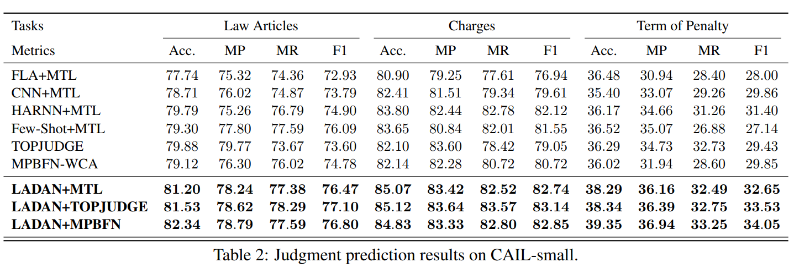
LADAN

Slide 21
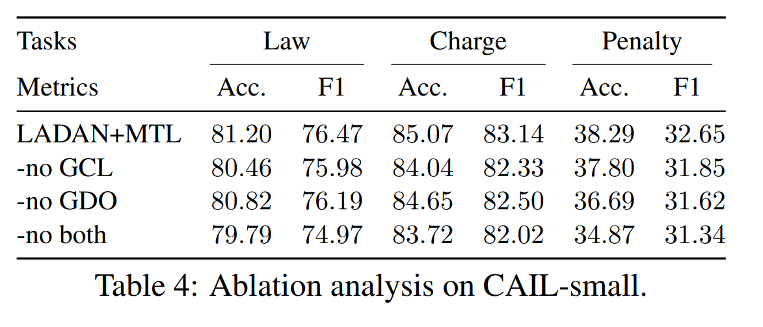
LADAN

Slide 22
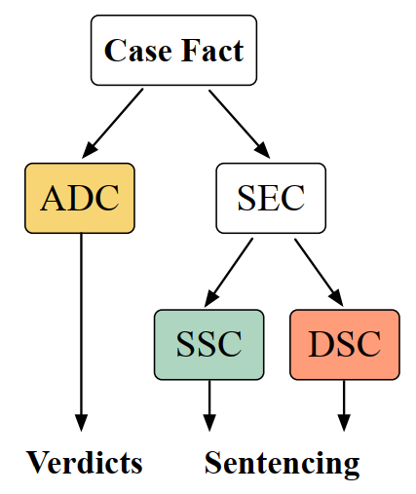
NeurJudge
ADC: ADjudging Circumstance
SEC: SEntencing Circumstance
SSC: Statutory Sentencing Circumstance
DSC: Discretionary Sentencing Circumstance
Notes:
ADC: A part of fact description which is in line with the definition of charge and decides the corresponding verdicts.
SEC: A part of fact description which determines the terms of penalty under the premise that a certain act has constituted a crime.
SSC: The relevant circumstances expressly provided for in the Criminal Law, which must be taken into account in sentencing.
DSC: Circumstances that need to be considered when sentencing according to the legislative spirit and trial practical experience.

Slide 23
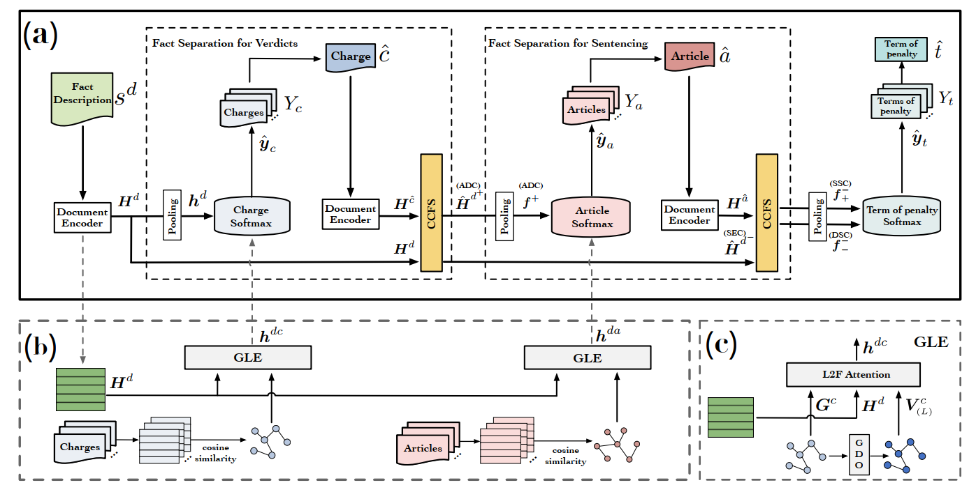
NeurJudge

Slide 24
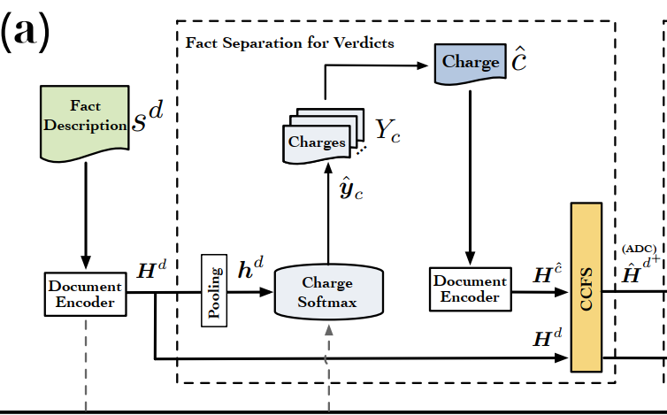
NeurJudge

Slide 25
NeurJudge

Slide 26
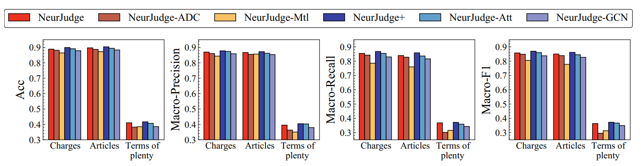
NeurJudge

Slide 27
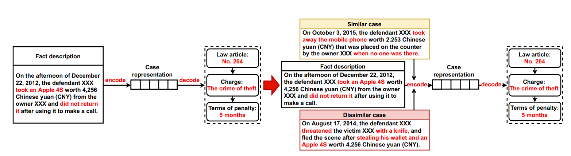
CTM

Slide 28
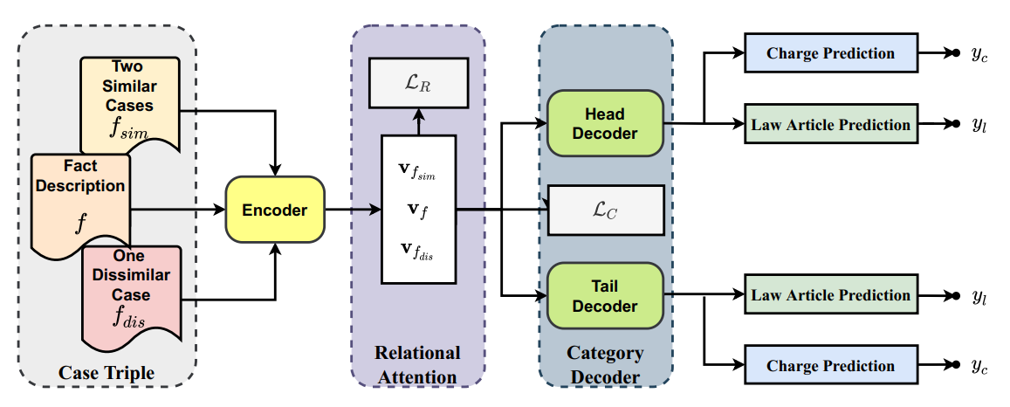
CTM

Slide 29
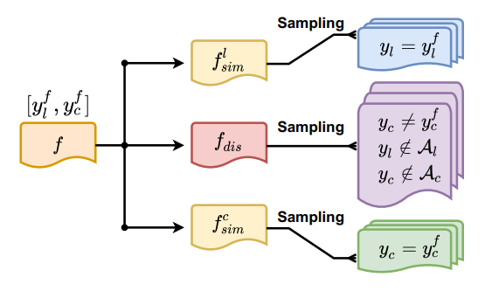
CTM

Slide 30
Contents
Background
Related Works
TopJudge
LADAN
NeurJudge
CTM
Conclusion

Slide 31
Conclusion
TopJudge: Dependencies among multiple tasks
LADAN and NeurJudge: Confusing law articles/charges
CTM: Label imbalance

Slide 32
Q&A

